Slide 1
AMAZON SALES
DATA ANALYSIS REPORT
Manish Jha

Slide 2
Problem Statement
Objective
Benefits
Help out to make better business decisions.
Help analyze customer trends and satisfaction, which can lead to new and better products and services.
Gives better insight of customers base.
Helps in easy flow for managing resources.
Sales management has gained importance to meet increasing competition and the need
for improved methods of distribution to reduce cost and to increase profits. Sales
management today is the most important function in a commercial and business
enterprise.
Develop a Report by Extracting-Transforming-Loading of data which contains Sales trend with respect to Year, Month, Quarter and find Some relationships through data to understand and Analyze the Facts.

Slide 3
Most Profitable & Most Sold Item
Cosmetics is most sold and most profitable items among all from all countries and region ﻿

Slide 4
Sales Channel Comparison
There is no such preference when it comes to mode of shopping both online and offline has same number of orders

Slide 5
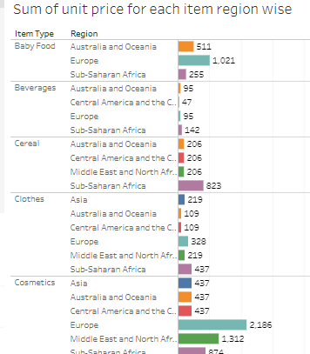
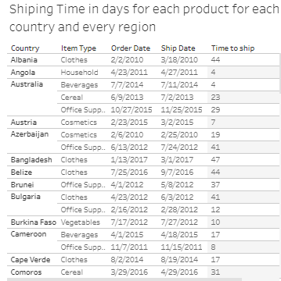
Sum of unit price and shipping time in days region and country wise
﻿

Slide 6
Conclusion
Cosmetics is most sold and most profitable items among all from all countries and region ﻿
2. There is no such preference when it comes to mode of shopping both online and offline has same number of orders

